Slide 1


MINI PROJECT Presentation
on
Data-Driven Machine Learning Approaches for Lithium-ion Battery Remaining Useful Life Prediction
Seminar Guide :
Dr.A.Jothi Prabha.
Associate Professor, Dept. of CSE (AI&ML).
Presented by :
B22AI009
Adi Sai Kiran

Slide 2

Abstract
The rapid advancement of electric vehicle (EV) technology emphasizes the importance of lithium-ion batteries for sustainable energy storage. This research focuses on predicting the Remaining Useful Life (RUL) of lithium-ion batteries using machine learning (ML) models like Random Forest (RF) and Support Vector Machine (SVM). The study employs a dataset from NASA Ames Prognostics Center of Excellence, utilizing preprocessing techniques such as feature selection via One-Way ANOVA and hyperparameter tuning to optimize model performance. The RF model achieves an R² score of 0.83 and a Mean Squared Error (MSE) of 1.67, demonstrating its effectiveness in battery life prediction. This research contributes to enhanced battery management systems, improving efficiency and sustainability.

Slide 3
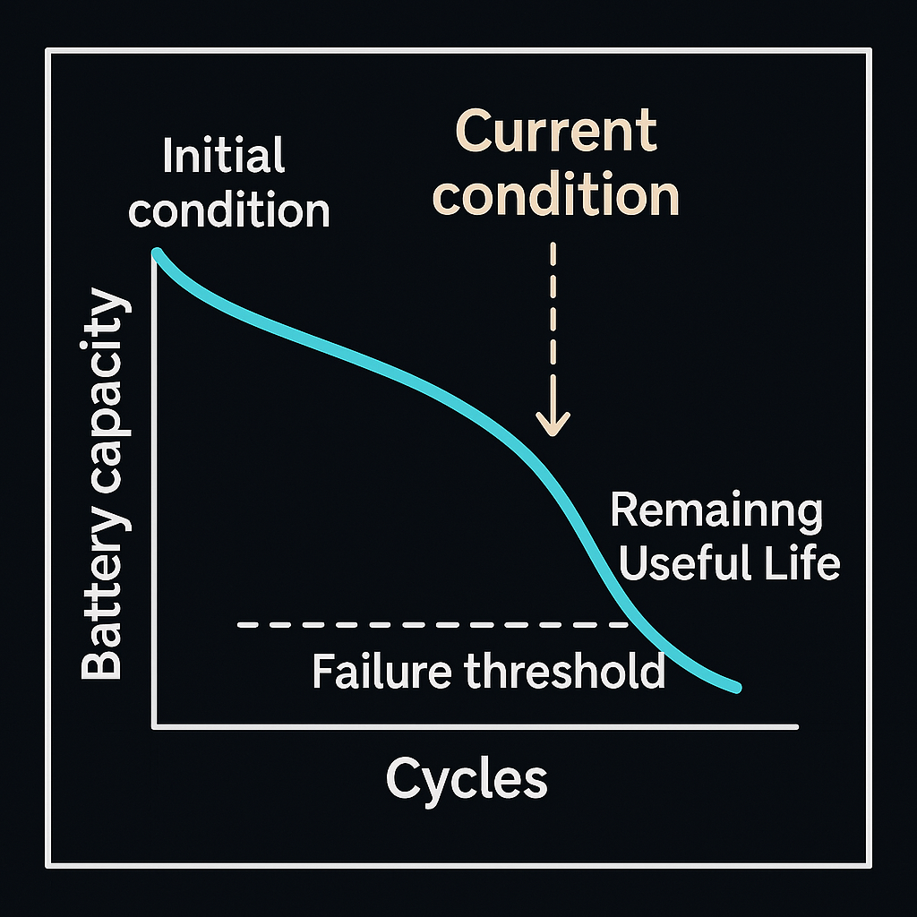
Problem Statement
Lithium-ion batteries degrade over time due to temperature fluctuations, charge/discharge cycles, and environmental conditions. Accurately predicting the Remaining Useful Life (RUL) of EV batteries is essential for optimizing performance, reducing operational costs, and ensuring safety. Traditional methods struggle with the non-linear nature of battery degradation, making machine learning-based approaches necessary.

Slide 4
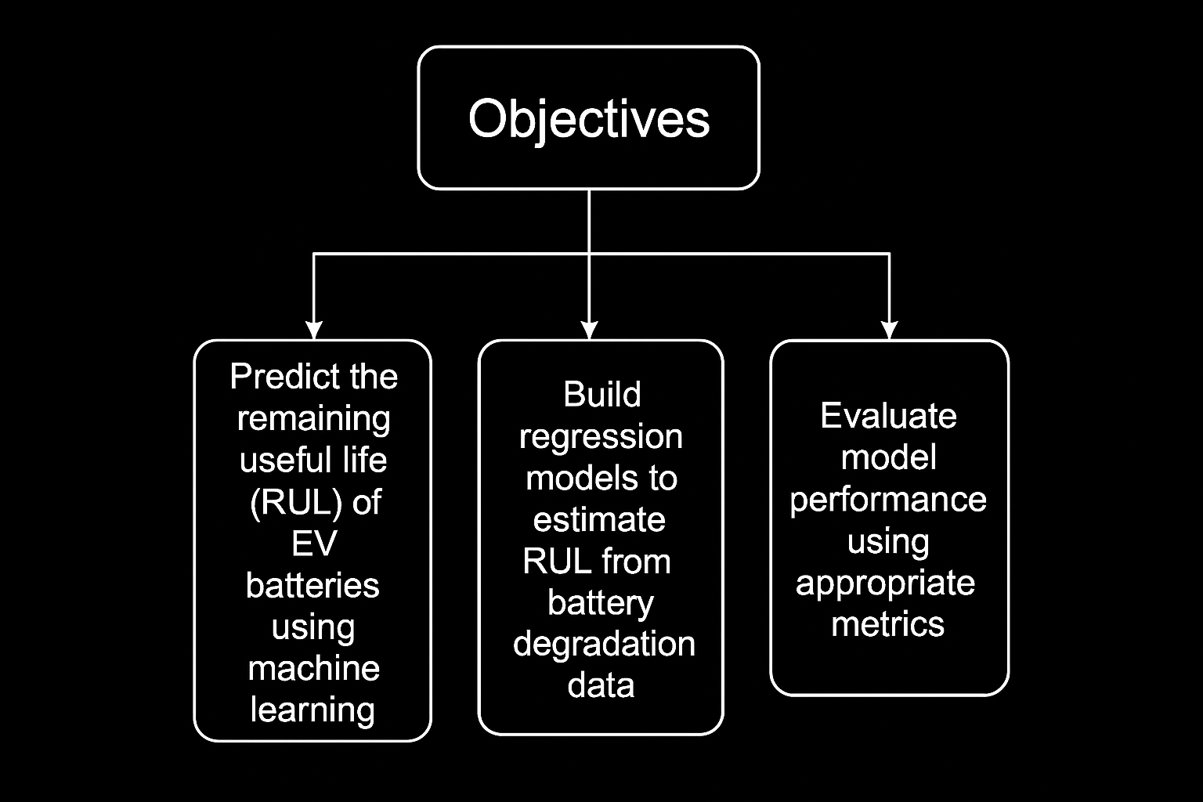
Objectives
Develop a predictive model to estimate the percentage decrease in battery capacity based on multiple features like voltage ,power and temperatue..
Develop a predictive model to estimate the percentage decrease in battery capacity based on temperature variations and the number of charge-discharge cycles

Slide 5
Requirements
Hardware Requirements
Software Requirements
Processor: Intel i5/i7 or AMD equivalent (Quad-Core or higher)
RAM: Minimum 8GB (16GB recommended for better performance)
Storage: Minimum 100GB free space (SSD recommended)
GPU: NVIDIA GPU with CUDA support (for deep learning models)
Operating System: Windows 10/11
Programming Language: Python 3.8+
Libraries & Frameworks:
TensorFlow / PyTorch (for deep learning models)
NumPy, Pandas, SciPy (for data processing)
Matplotlib, Seaborn (for visualization)
Scikit-learn (for machine learning algorithms)
Development Tools: Jupyter Notebook

Slide 6
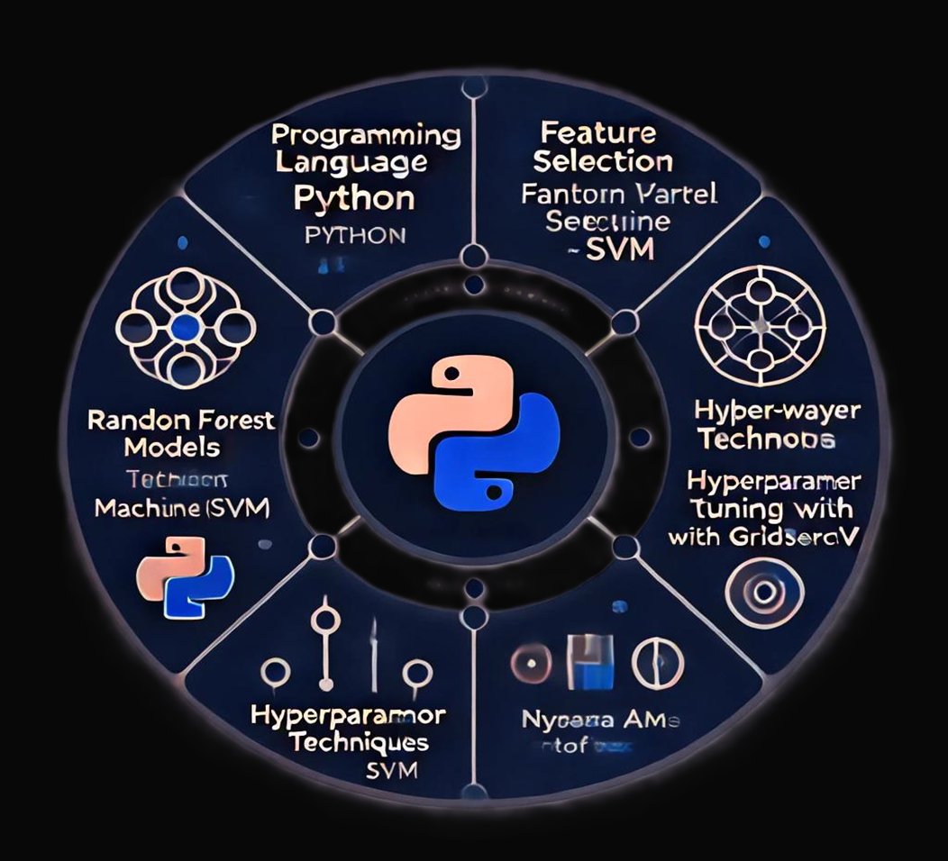
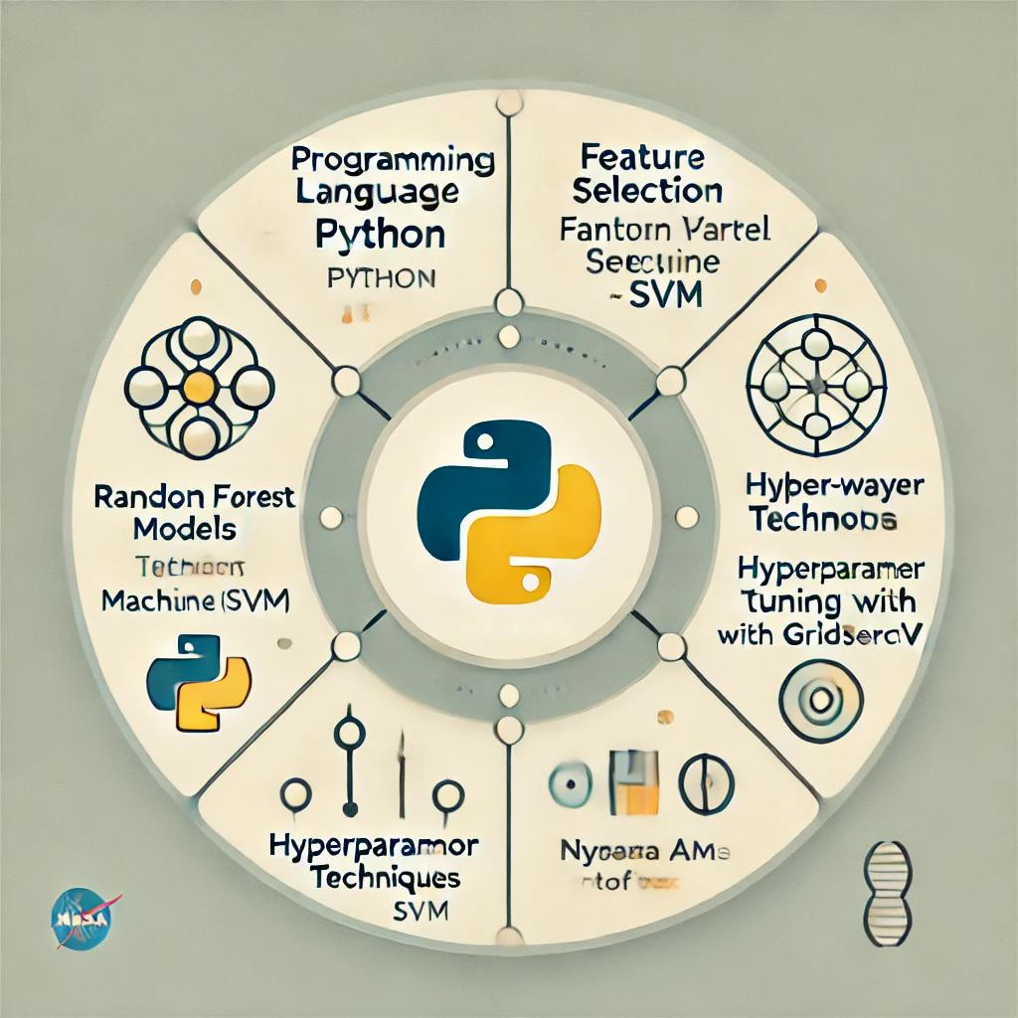
Tools and Technologies
Programming Language: Python
Machine Learning Models: Random Forest (RF), Support Vector Machine (SVM)
Feature Selection: One-Way ANOVA
Optimization Techniques: Hyperparameter tuning with GridSearchCV
Dataset: NASA Ames Prognostics Center of Excellence

Slide 7
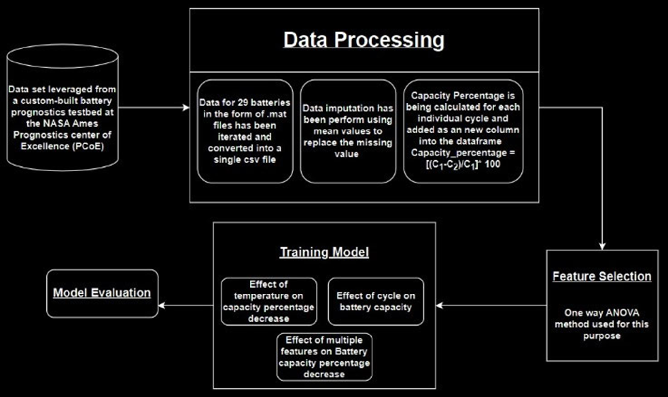
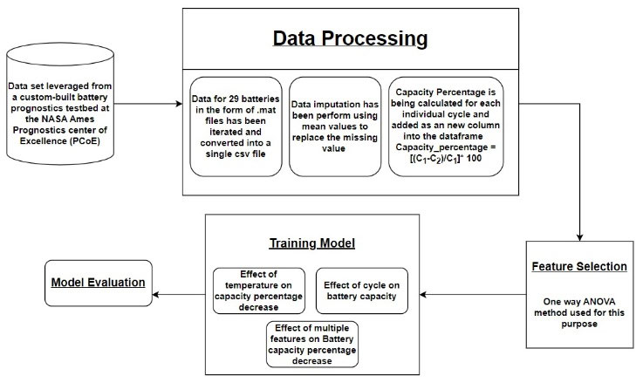
M
E
T
H
O
D
O
L
O
G
Y

Slide 8
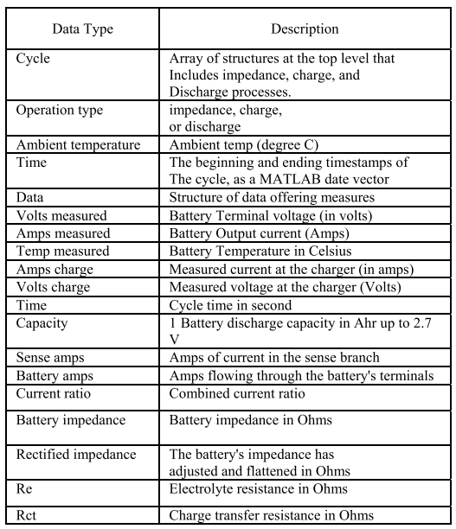
1. Data Collection and Structure:
Source: NASA Ames Prognostics Center of Excellence
(PCoE)
Format: .mat files
Total Batteries: 32
Data Structure: Cyclic data (charge, discharge, impedance operations)
Key Parameters:
Voltage
Current
Temperature
Impedance
Purpose: Used for battery prognostics and Remaining Useful Life (RUL) prediction

Slide 9
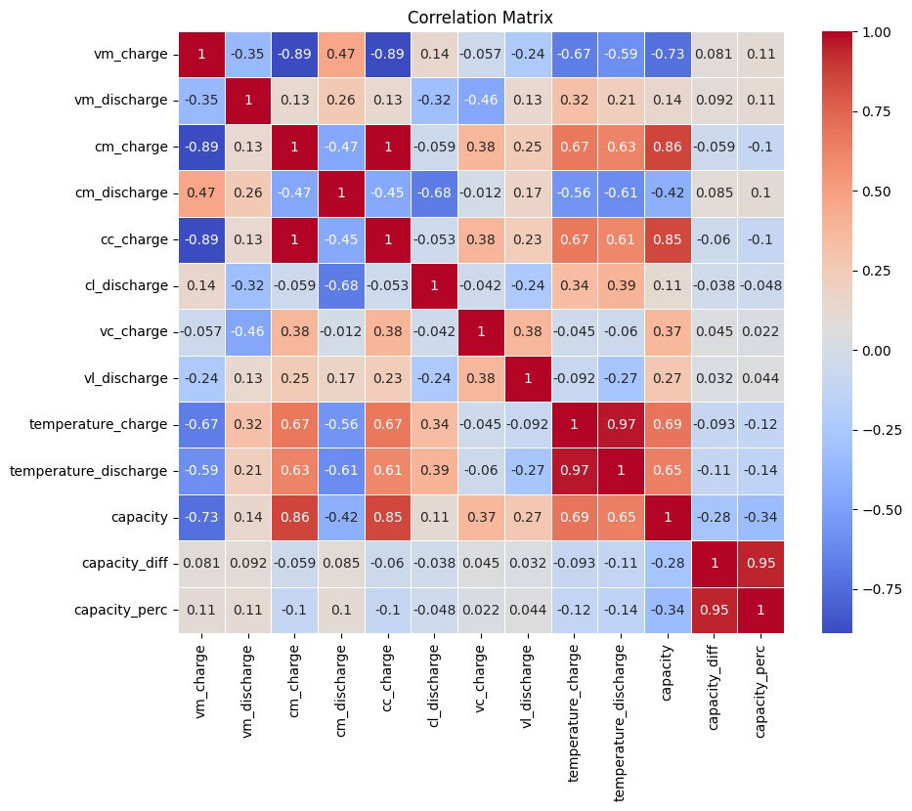
2. DATA PREPROCESSING
Data Extraction & Formatting:
Iterated through each .mat file (battery cycles)
Converted data into a CSV file for easier handling and analysis
Capacity Percentage Decrease Calculation:
Formula: %age = ((C1 − C2) / C1) × 100
C1: Maximum available capacity of the current cycle
C2: Maximum available capacity of the next cycle
Helps in analyzing battery degradation patterns
Correlation Matrix Insights:
Identifies relationships between features and battery health
Temperature change & discharge cycles show strong correlation with battery capacity
Supports the use of regression models for predicting capacity decline

Slide 10
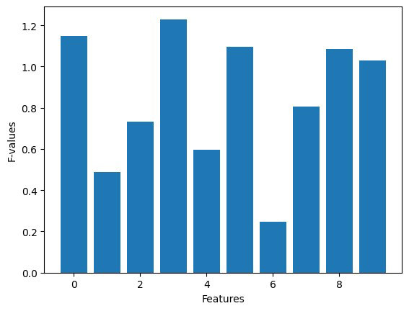
3. FEATURE SELECTION
Purpose:
Identifies the most impactful features for battery degradation prediction
Reduces model complexity while improving accuracy
Methodology:
One-Way ANOVA (Analysis of Variance) is used to evaluate feature significance
Compares variance within groups vs. variance between groups using F-statistic
Feature Importance Evaluation:
Features with higher F-values are more significant
Helps in selecting key parameters affecting battery life deterioration

Slide 11
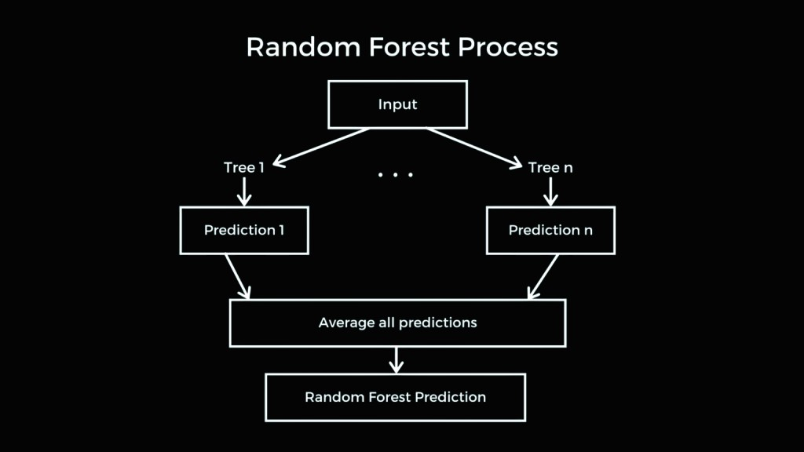
4. MACHINE LEARNING MODELS
• Ensemble Learning Algorithm: Combines multiple decision trees.
• Bagging Technique: Each tree is trained on a random subset of the data.
• Feature Randomness: Uses a random subset of features for splitting nodes.
• Prediction Method:
Regression: Takes the average of individual tree outputs.
Classification: Uses majority voting among trees.
• Advantages:
Improves accuracy.
Reduces overfitting compared to a single decision tree.
Handles missing data effectively.
Works well with high-dimensional datasets.

Slide 12
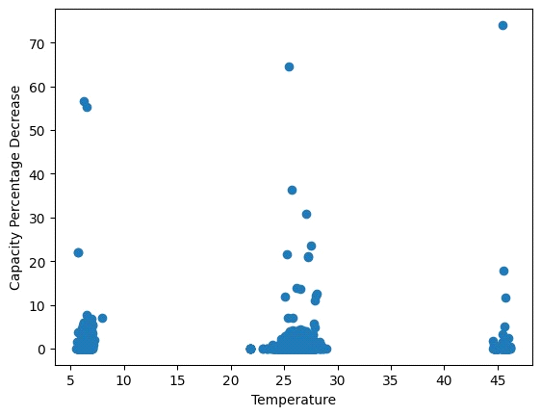
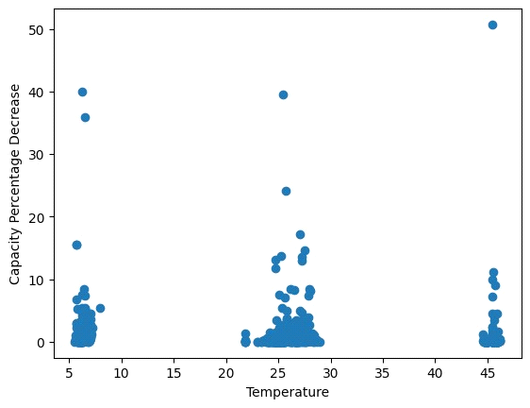
Expected Output / Desired Results
Prediction of Capacity Decrease Due to Temperature
RF model accurately predicts capacity degradation with an R² score of 0.83 and MSE of 1.67.

Slide 13
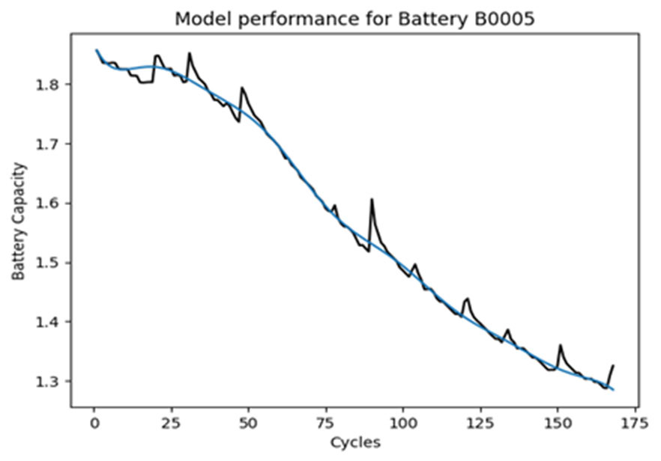
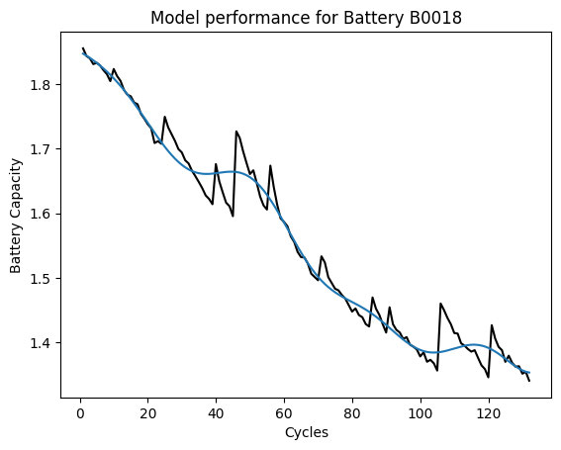
Prediction of Battery Capacity vs. Cycles (for multiple batteries).
Prediction of Capacity Decrease with Multiple Features
RF model predicts capacity based on voltage, current, and temperature with an R² score of 0.73.

Slide 14
Performance Metrics
The models are evaluated using:
R² Score: Measures the model's ability to explain variance.
RF Model: 0.83
SVM Model: 0.90 - 0.99
Mean Squared Error (MSE): Measures prediction error.
RF Model: 1.67
SVM Model: Lower values indicate high accuracy.
METHOD | ERROR
BY LSTM | 2%
BPNN | 5%
SVR | 10.9%
GRNN | 4.3%
PSO RF | 3%
Deep Neural Network | 6.6%
Proposed system (Tuned RF) | 1.67%

Slide 15
Conclusion
Accurate RUL Prediction: Applied Random Forest (RF) and Support Vector Machine (SVM) models for Remaining Useful Life (RUL) estimation of Li-ion batteries.
Data Preprocessing: Rigorous cleaning and feature selection using One-way ANOVA, identifying 7 key factors out of 10 affecting battery life.
Model Performance:
RF Model achieved R² = 0.83 and MSE = 1.67, proving effective in predicting capacity decline due to temperature changes.
Impact on EV Battery Management: Findings contribute to improving Battery Management Systems (BMS) in electric vehicles.
Future Enhancements:
Expanding Dataset: Incorporating diverse data for more robust models.
Deep Learning Integration: Exploring neural networks to improve prediction accuracy.
IoT & Real-Time Data: Using sensors and IoT devices for real-time monitoring and hybrid ML-based analytics to further enhance RUL estimation.

